Slide 1
Sentiment Analysis for Enhanced Customer Churn Prediction in E-commerce
Team No. 45
ID: 20101477
Name: Md. Sifat Mahmud
ID: 21301232
Name: Irfanul Haque
ST Name: Sabbir Hossain and Mehnaz Ara Fazal

Slide 2
Introduction
Digital Shift in E-commerce:
The E-commerce sector is witnessing a digital revolution, altering the landscape of consumer behavior and business strategy.
Churn as a Key Challenge:
Customer churn, where customers cease their relationship with a business, poses a major challenge, impacting growth and sustainability.
Predictive Analytics' Role:
Predictive analytics is crucial for identifying patterns in customer behavior, helping businesses to preemptively address churn.
Research Aim:
Our research aims to integrate sentiment analysis with churn prediction models, offering a novel approach to tackle customer retention in E-commerce.

Slide 3
Literature Survey
Building on a strong foundation: We leverage existing studies on tailoring models to customer behaviors and industries for a robust foundation.
Sentiment analysis unlocks emotional insights: We integrate sentiment analysis to understand customer emotions, adding a powerful new layer to traditional prediction methods.
Combining the best of both worlds: The research pioneers the integration of sentiment analysis with churn prediction models, providing a richer understanding of E-commerce customer behavior.
Machine learning symphony: The use of diverse algorithms like Logistic Regression, Decision Trees, and Random Forests to overcome individual limitations and deliver more accurate and resilient predictions.
NLP takes center stage: Natural Language Processing empowers the process of sentiment analysis,

Slide 4
Collected Data
Data Source:
Kaggle dataset which provides in-depth insights into E-commerce customer behaviors and churn trends."
Data Features:
"The dataset includes diverse features such as customer demographics, purchase history, and review texts, offering a comprehensive view."

Slide 5
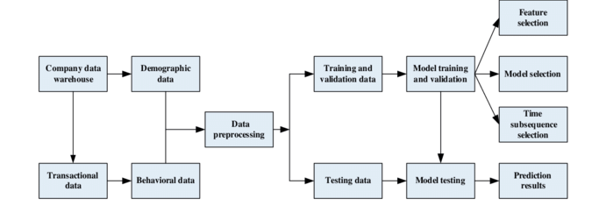
Methodology
Data & Preprocessing
Normalization: Rescale numerical features for improved model performance.
Missing Value Management: Imputation or elimination to preserve data integrity.
Feature Extraction: Identify key features for accurate prediction.
Tokenization: Split text into individual words/tokens.
Stemming/Lemmatization: Reduce words to root/dictionary form for better semantic understanding.
Model Training, implementation and evaluation.
Churn prediction models
Sentiment Analysis

Slide 6
Methodology
Churn Prediction Models
Logistic Regression
Binary classification (churn/not churn) with feature selection and interpretation.
Naive Bayes
Probability-based for text data (sentiment), assuming feature independence. Evaluated for churn prediction.
Support Vector Machine (SVM)
Advanced class boundaries with kernels. Parameter optimization for best performance.
Random Forest
Combines multiple decision trees for robust and accurate predictions, resistant to overfitting. Tuning optimizes for complex churn patterns.

Slide 7
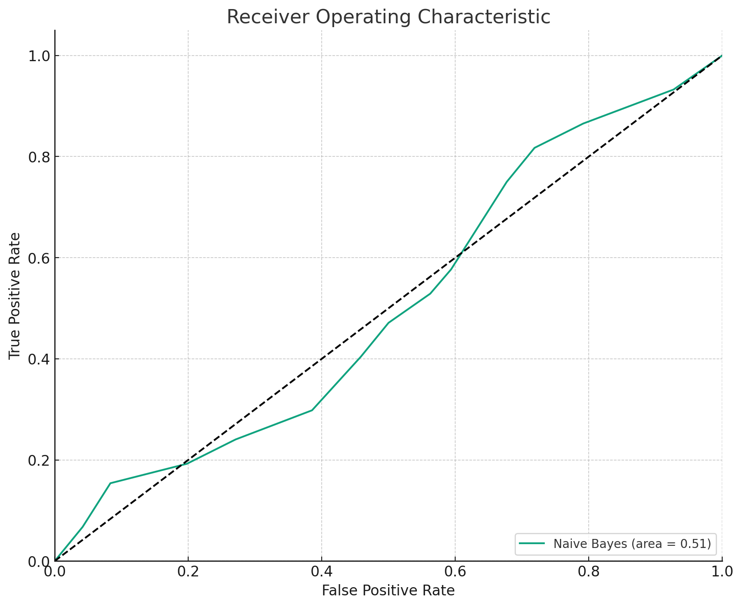
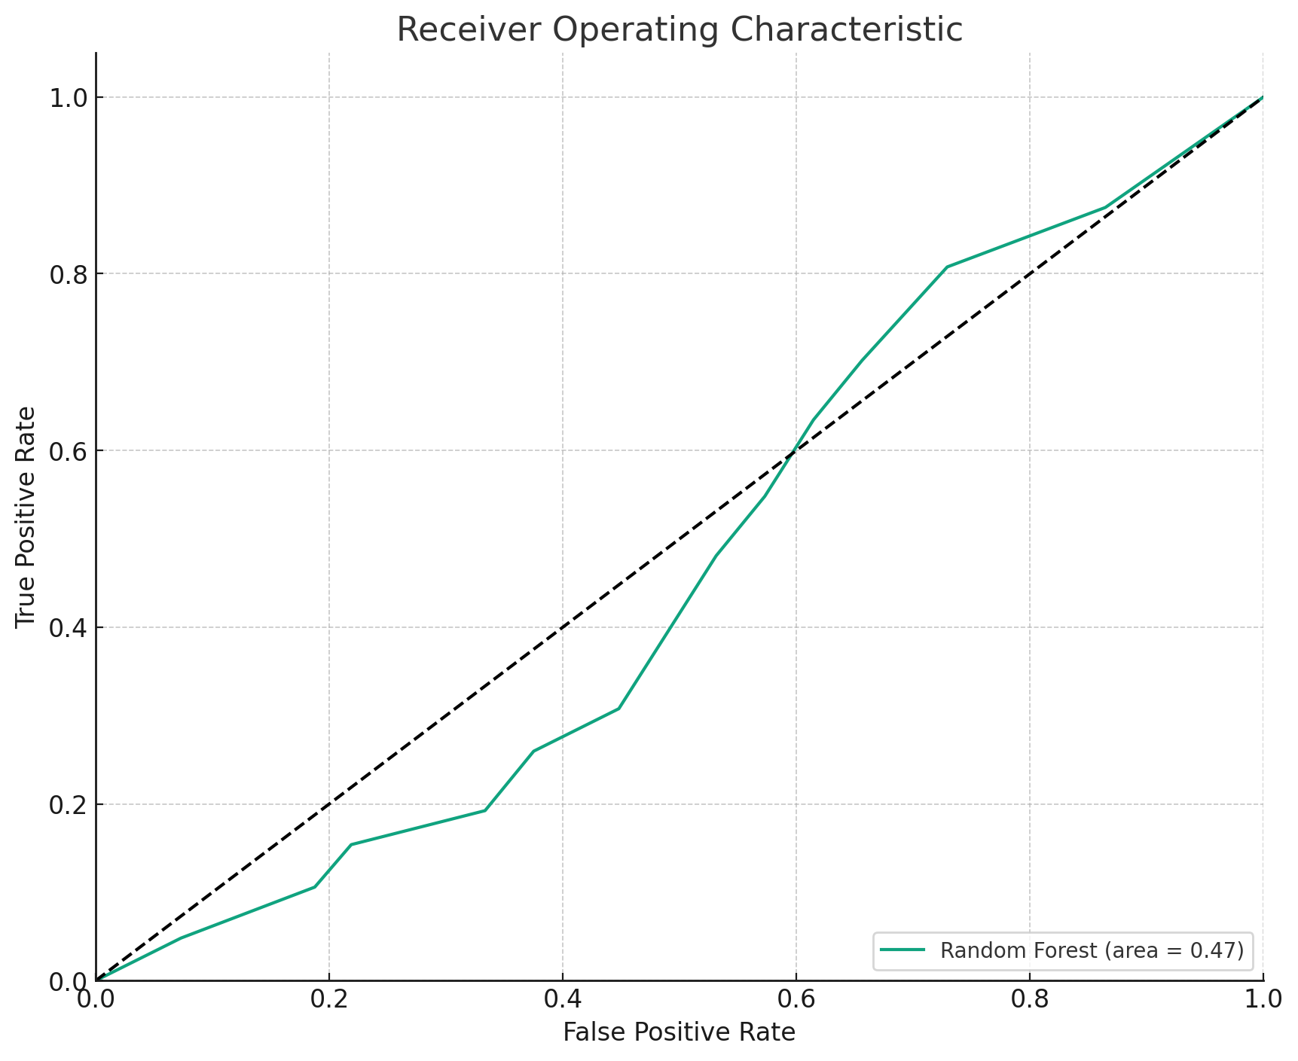
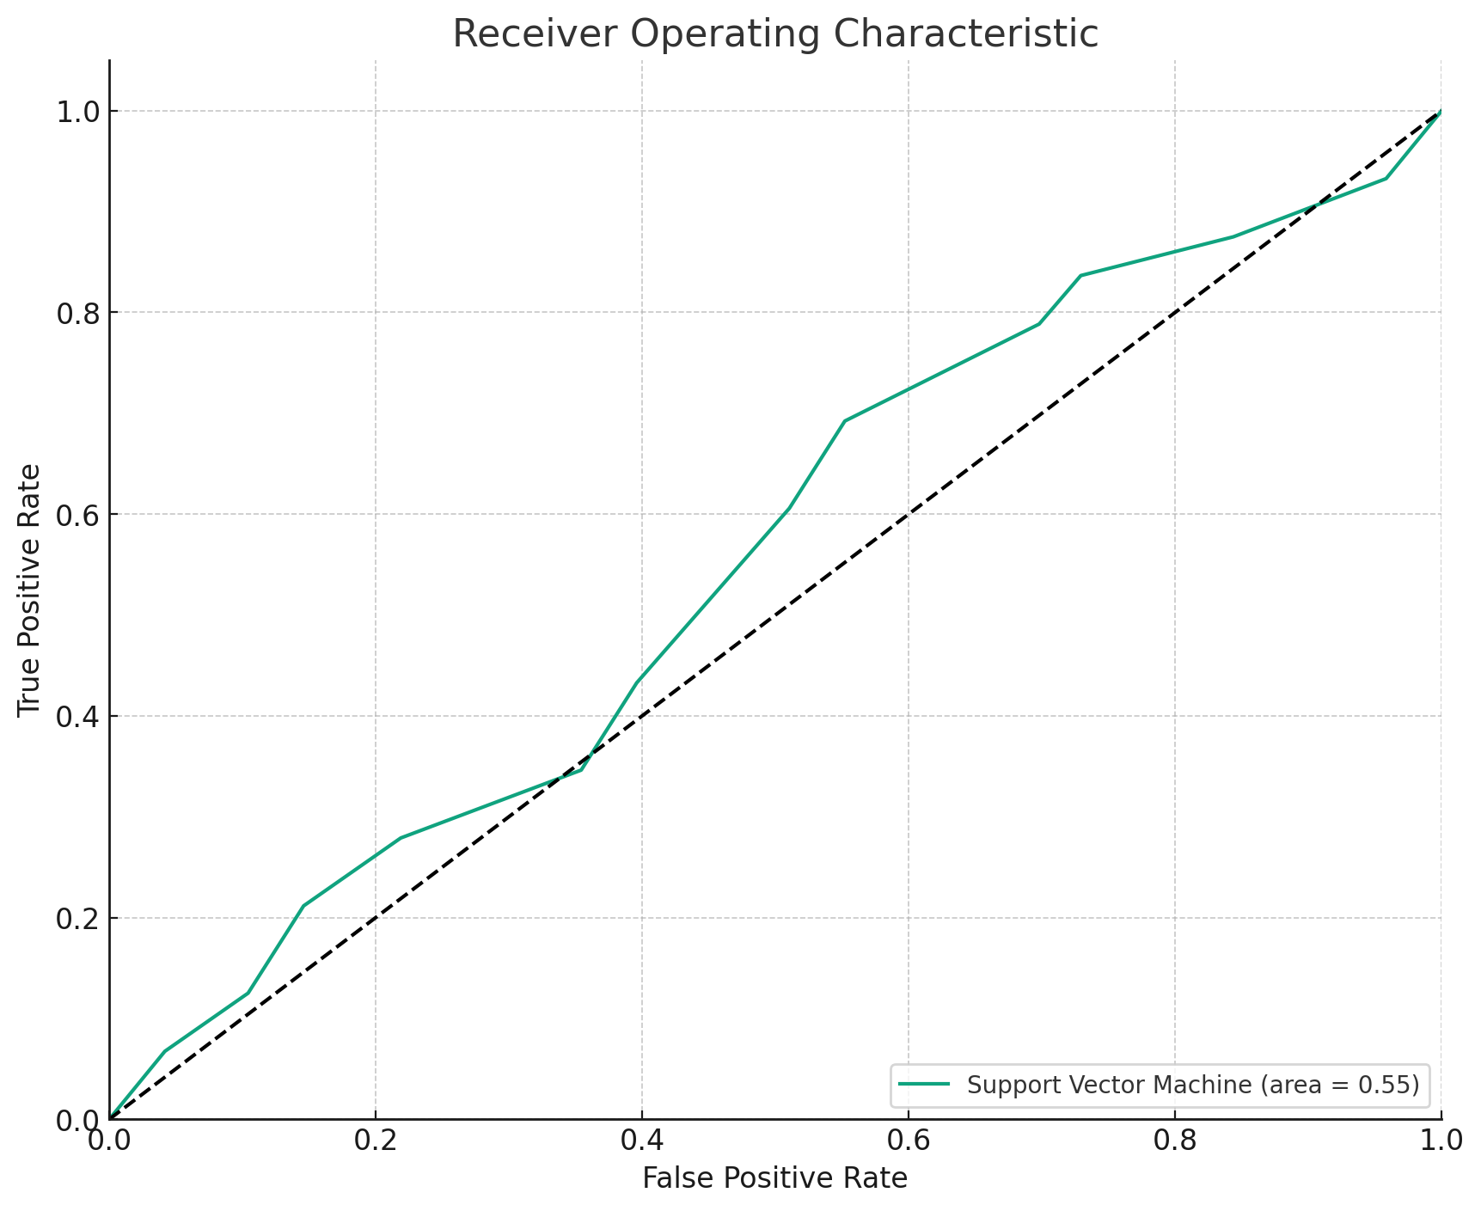
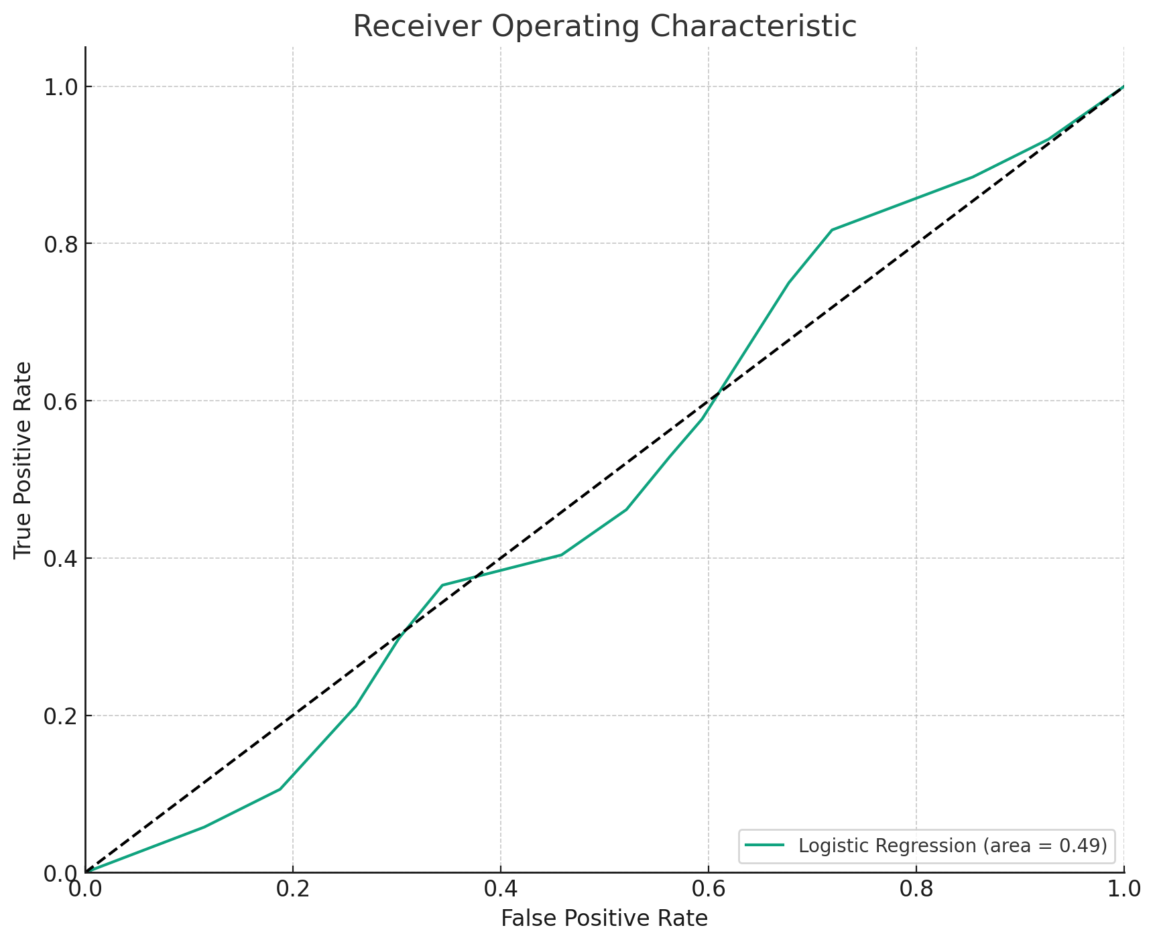
Implementation
Model Training & Validation:
Split data: Training to learn, validation to test.
Cross-validation: Ensures generalizability (K-Fold, Stratified).
Train models: Each methodology optimized for churn prediction.
Evaluation:
Metrics: Accuracy, precision, recall, F1, ROC-AUC.
Visualization: Confusion matrices & ROC curves for insights.
Integration:
Combine sentiment scores with features.
Identify top predictors for churn.

Slide 8
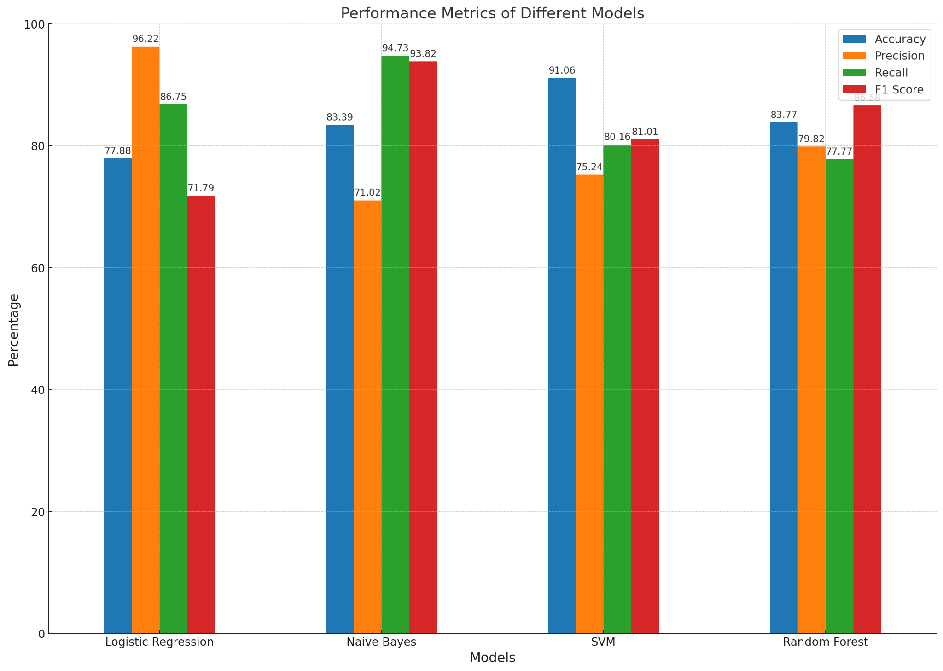
Result Analysis
Top Performer: Logistic Regression (96.22% Precision, 98.52% AUC).
Other Models:
Naive Bayes: High recall (94.73%) but lower precision (71.02%) and AUC (70%)
SVM: Good balance (91.06% accuracy) but average Precision (75.24%). and AUC (74.32%)
Random Forest: Decent overall (83.77% accuracy) and high discriminatory power (92.59% AUC).

Slide 9
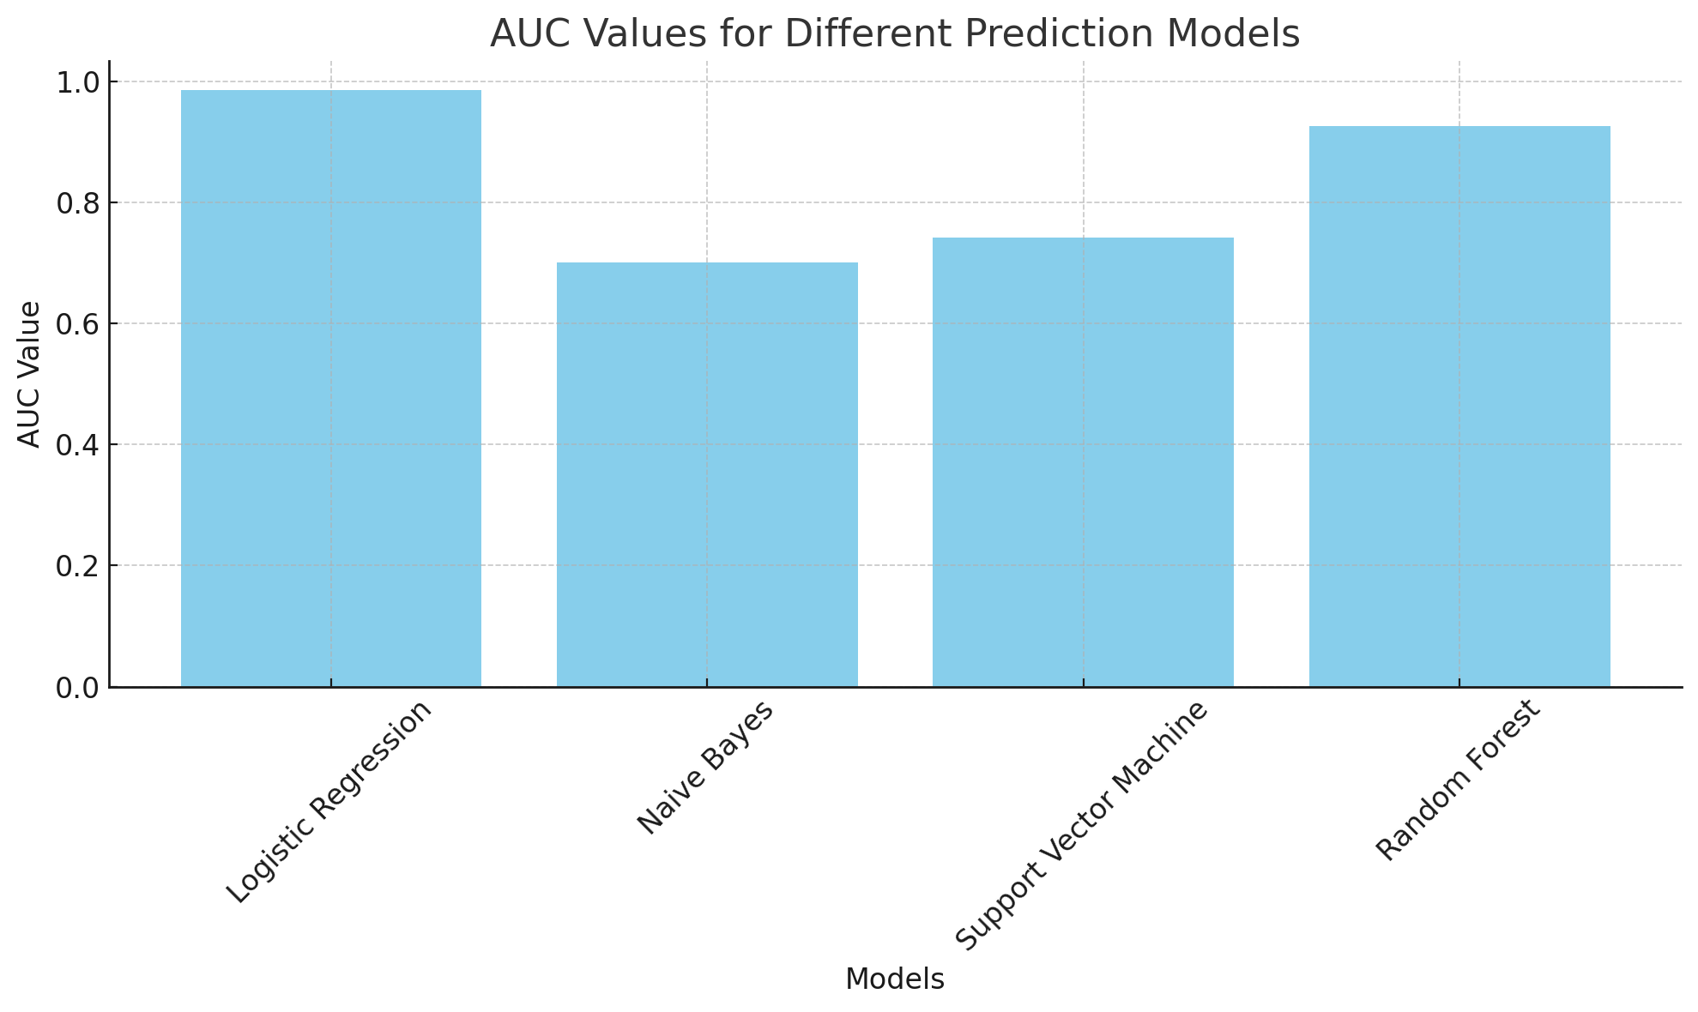
Result Analysis
Why Logistic Regression?
-Highest AUC - best at differentiating churners vs. non-churners.

Slide 10
Limitations:
Sentiment Analysis Method: Future research could explore more advanced NLP methods.
Model Generalizability: The current models are tailored for the dataset used and may not apply universally to all e-commerce scenarios.
Feature Selection: Certain influential factors, such as customer service interactions or website navigation experience, were not included. Future models could incorporate a broader range of features.

Slide 11
Future Works:
Advanced Sentiment Analysis Techniques: Utilizing deep learning and AI to achieve a more accurate and nuanced understanding of customer sentiments.
Hybrid Predictive Models: Developing models that combine various machine learning techniques to improve accuracy and reliability.
Comprehensive Customer Journey Analysis: Expanding the model to include various stages of the customer journey for a holistic churn prediction.
Economic Impact Assessment: Evaluating the cost-benefit of implementing these models in real-world settings, considering both the expenses and potential gains.

Slide 12
Conclusion
Sentiment analysis boosts churn prediction: All models improved with sentiment data, highlighting the power of understanding customer emotions.
Logistic Regression shines: Highest Area Under the Curve (AUC) of 98.52%, making it the best at differentiating churners from non-churners.

Slide 13
Thank You

